Slide 1


School of Computing and Information Technology, Eastern International University (EIU) - Vietnam

Slide 2

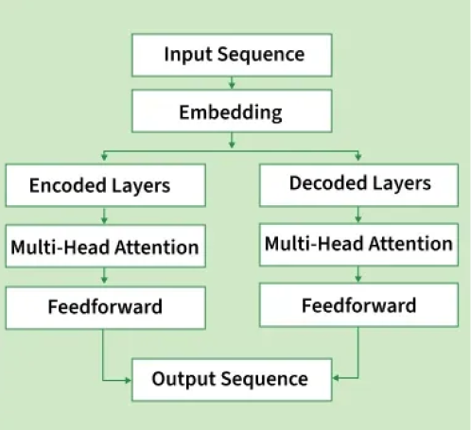
School of Computing and Information Technology, Eastern International University (EIU) - Vietnam

Slide 3
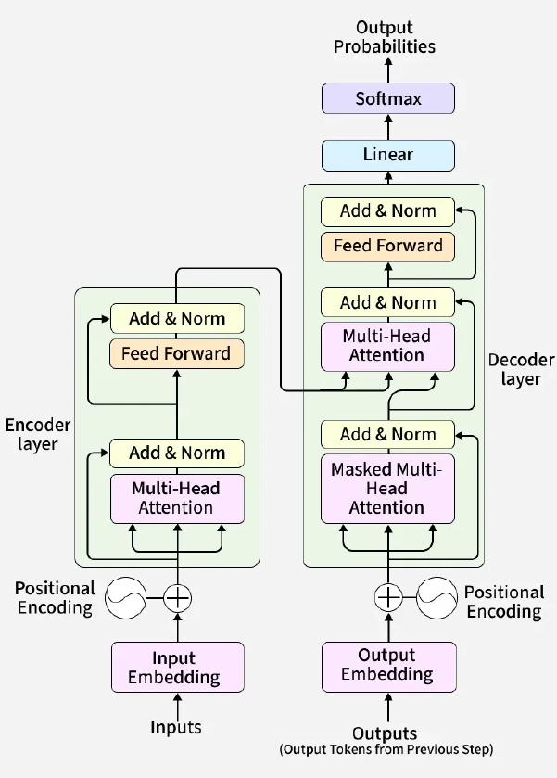
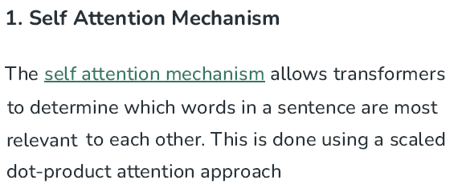
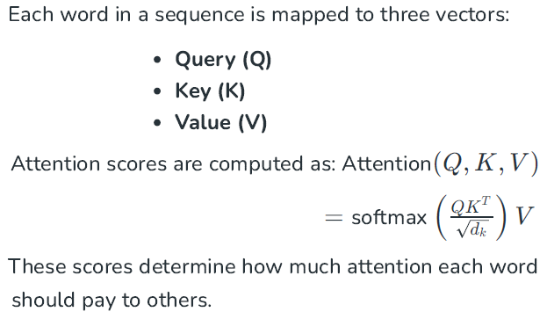

Slide 4



Slide 5


School of Computing and Information Technology, Eastern International University (EIU) - Vietnam

Slide 6
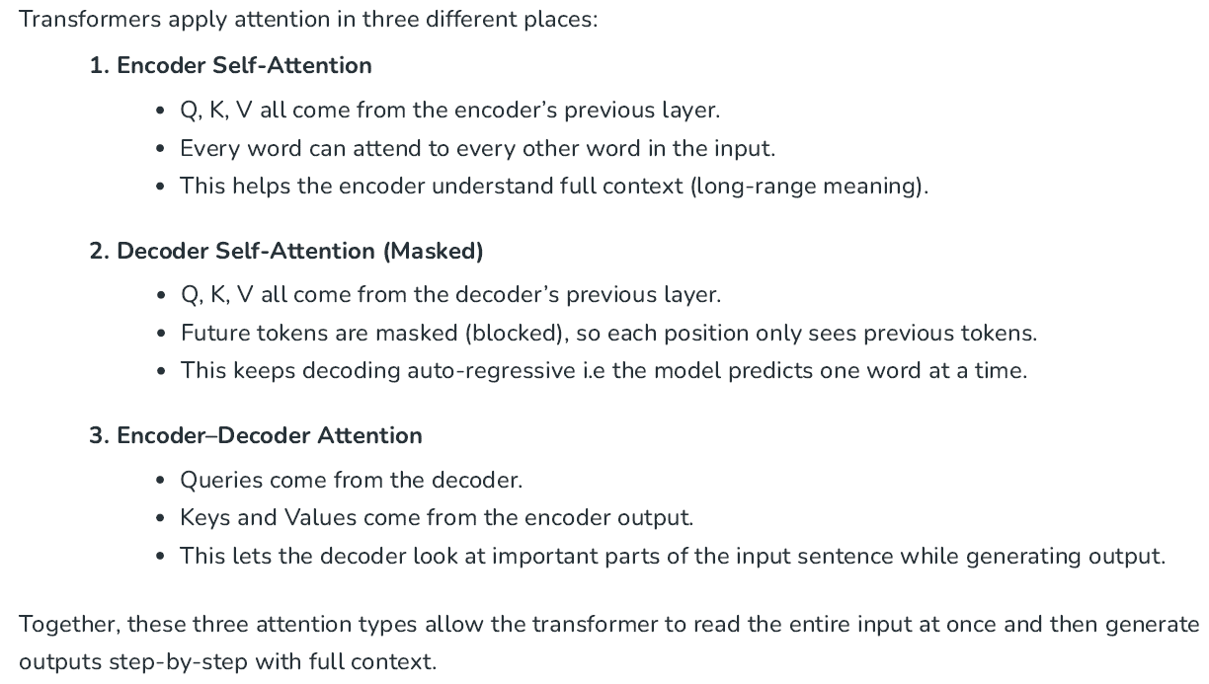

Slide 7



School of Computing and Information Technology, Eastern International University (EIU) - Vietnam

Slide 8


School of Computing and Information Technology, Eastern International University (EIU) - Vietnam

Slide 9



School of Computing and Information Technology, Eastern International University (EIU) - Vietnam

Slide 10


School of Computing and Information Technology, Eastern International University (EIU) - Vietnam

Slide 11
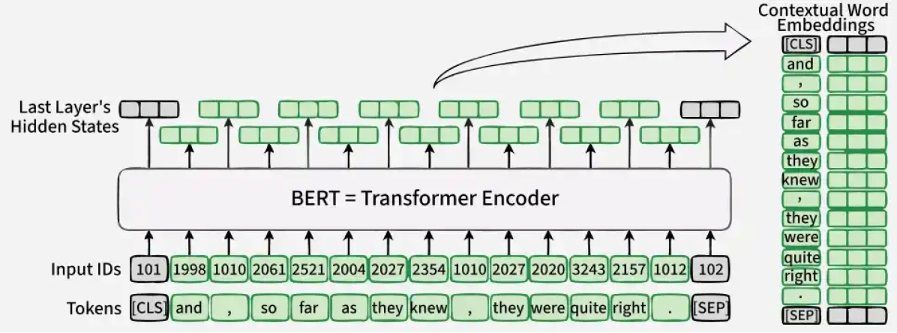


Slide 12
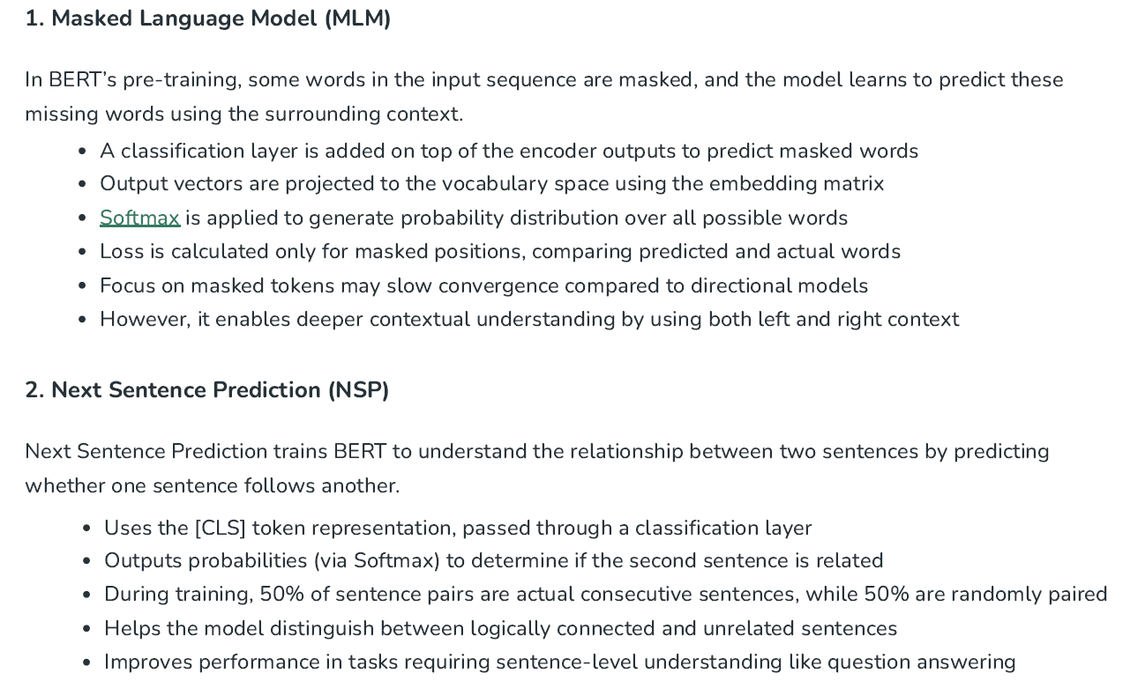

Slide 13



Slide 14


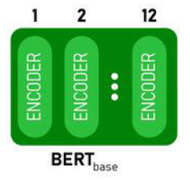
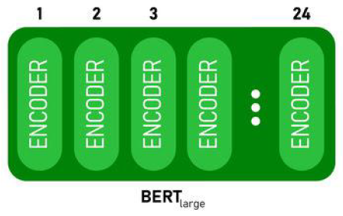


Slide 15

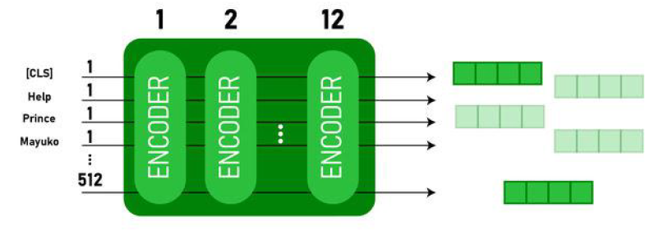


School of Computing and Information Technology, Eastern International University (EIU) - Vietnam

Slide 16
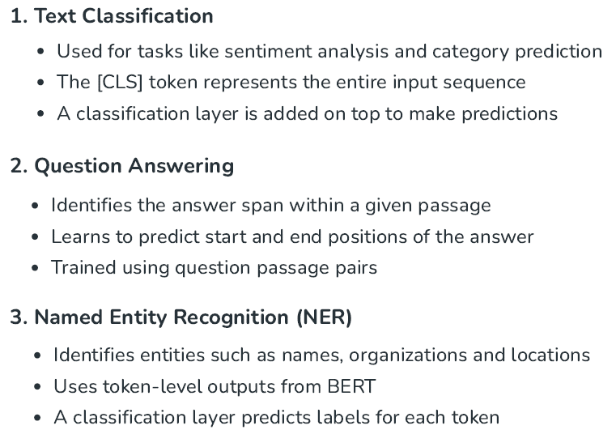
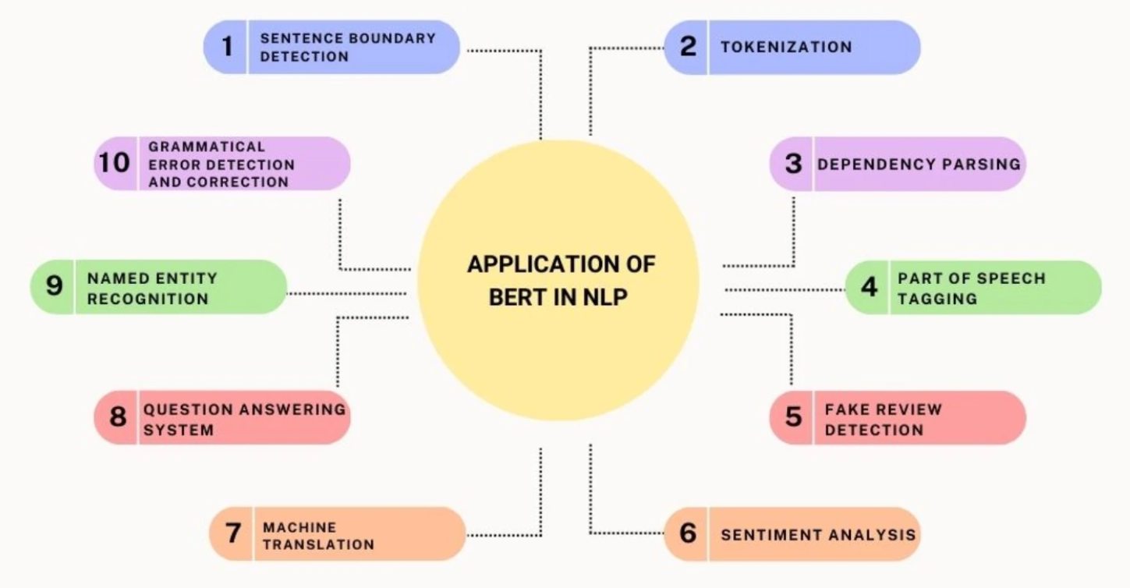
School of Computing and Information Technology, Eastern International University (EIU) - Vietnam

Slide 17







Slide 18


School of Computing and Information Technology, Eastern International University (EIU) - Vietnam

Slide 19
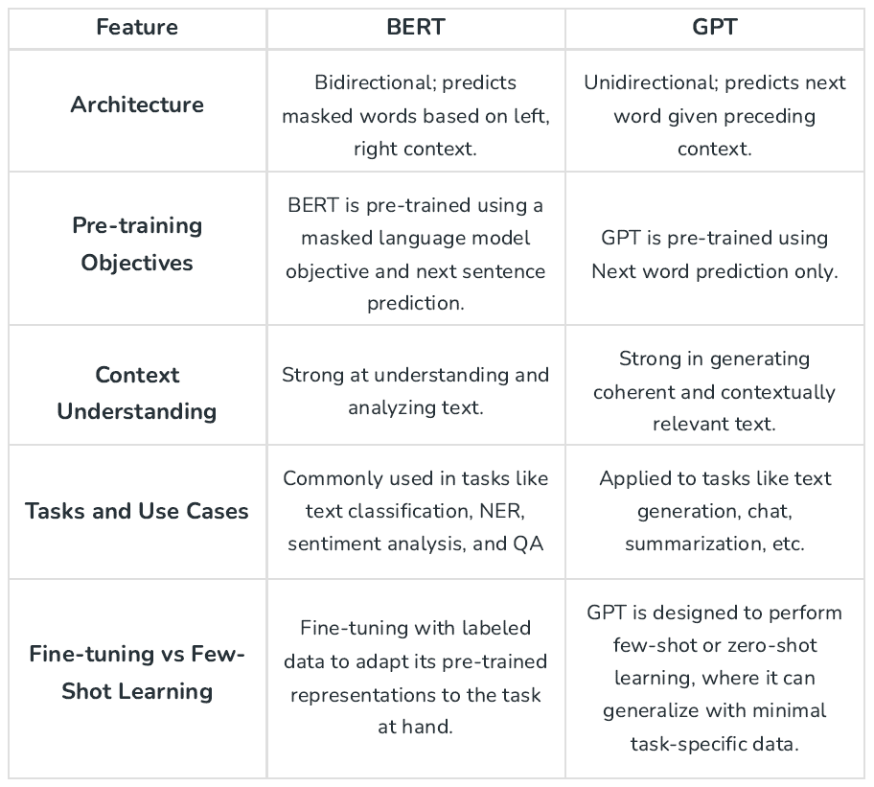

School of Computing and Information Technology, Eastern International University (EIU) - Vietnam

Slide 20
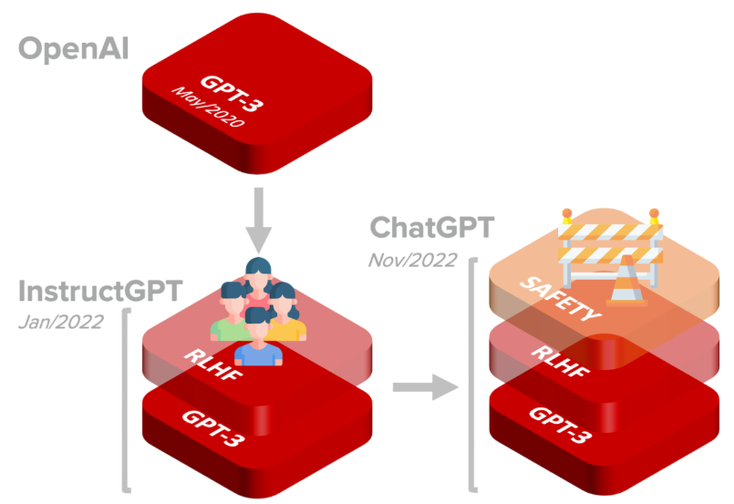

School of Computing and Information Technology, Eastern International University (EIU) - Vietnam

Slide 21


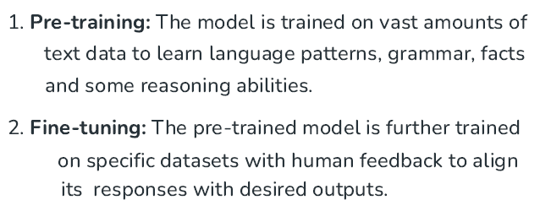


School of Computing and Information Technology, Eastern International University (EIU) - Vietnam

Slide 22

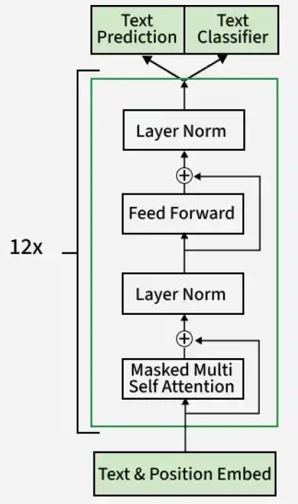


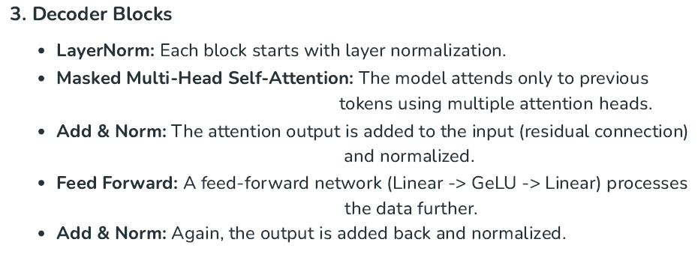

Slide 23

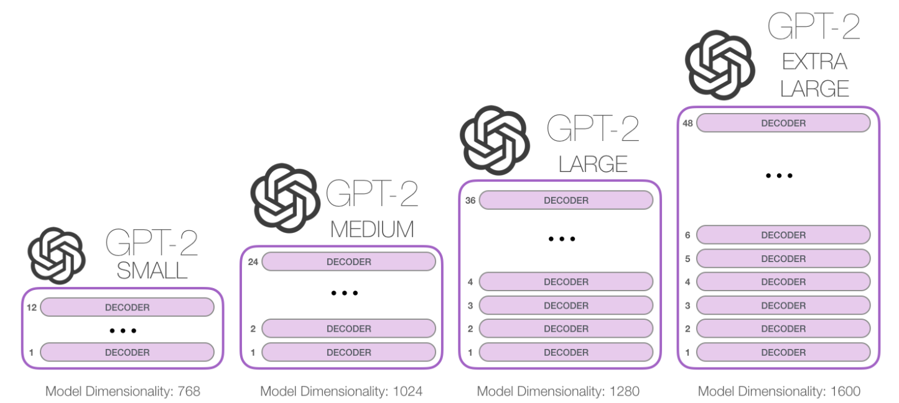
School of Computing and Information Technology, Eastern International University (EIU) - Vietnam

Slide 24

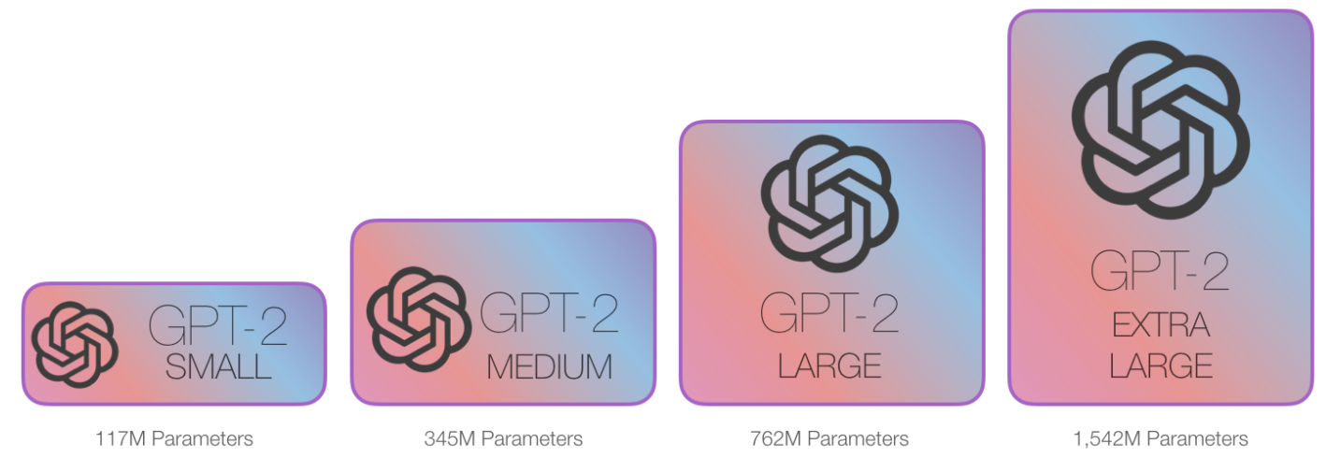
School of Computing and Information Technology, Eastern International University (EIU) - Vietnam

Slide 25
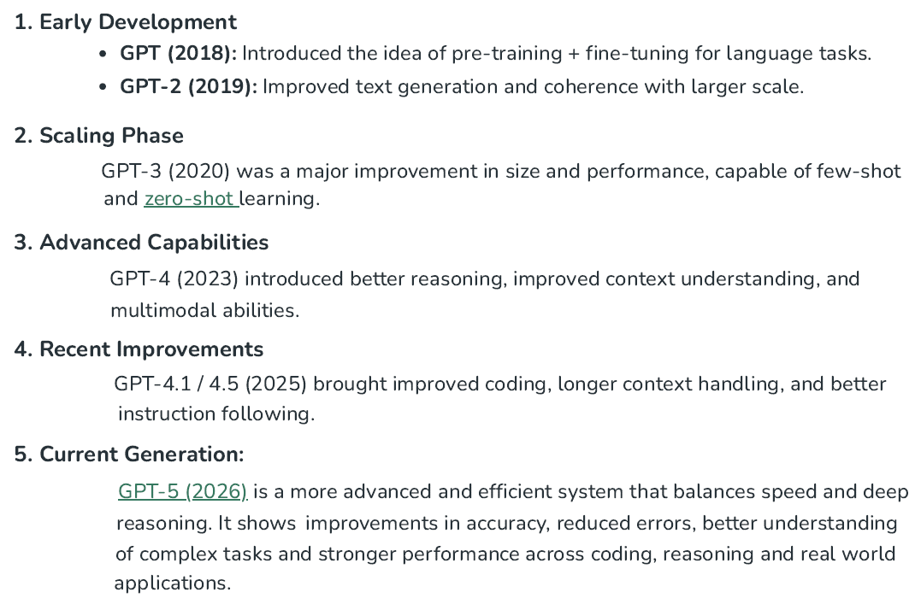

Slide 26


School of Computing and Information Technology, Eastern International University (EIU) - Vietnam

Slide 27
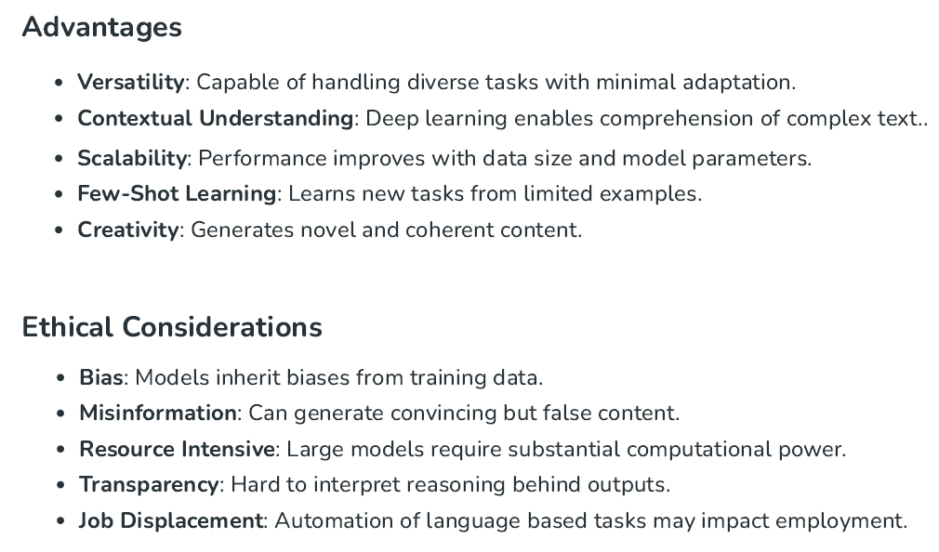
School of Computing and Information Technology, Eastern International University (EIU) - Vietnam

